Slide 3
Margaret Atwood
Margaret Eleanor Atwood is a Canadian poet, novelist, literary critic, essayist, inventor, teacher, and environmental activist.
Born: 18 November 1939 (age 80 years), Ottawa, Canada

Slide 4
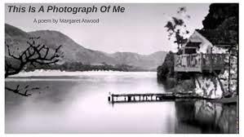

Slide 5
